Slide 1
Related and Related table
Related and Related table

Slide 2
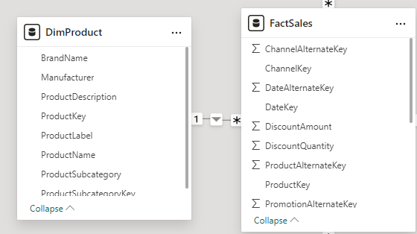
Related and Related Table
Note: This demo uses both DimProduct and FactSales tables
Note that the relationship from DimProduct to FactInterneSales is 1 to many

Slide 3
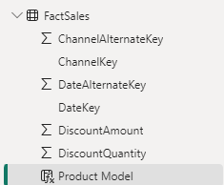
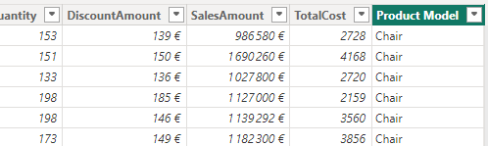
Related and Related Table
Note: This demo uses both DimProduct and FactSales tables
Add a new calculated column to the FactInternetSales table named Product Model
Product Model=RELATED(DimProduct[BrandName])
Product Model column should be located at the FactInternetSales table level

Slide 4
Related and Related Table
To represent a field at the DimProduct level from FactInternetSales we consider representing the last product date key at the column level
Create a column in name is Last Date Key which represents the key of the last date
Last Date Key = MAXX(RELATEDTABLE(FactSales),MAX(FactSales[DateKey]))
Notice that a column has just been added to the collection of columns called Last Date Key which contains values corresponding to the last date of embarkation

Slide 5
Thank you
Thank you

